Slide 1

Oil Production Forecast
Forecasting Project
Paritosh Sinha – 12220056

Slide 2

Overview
Crude oil a.k.a. “Industrial Blood” is the largest traded commodity in the world accounting to ~10% of the world traded commodities. Hence, any fluctuations in crude oil production impacts the national and global economy.
As efficient resource allocation in crude oil production is essential, this project targets enhanced forecast accuracy for short and long-term predictions, supporting strategic decision-making in oil-rich nations.

Slide 3
Data Mining Phase
Business and Data Understanding
This initial phase is concerned with tasks to define the business objectives and translate it to ML objectives, to collect and verify the data quality, and to finally assess the project feasibility.
Define the Scope of the ML Application
Business Problem : The existing challenges in accurately forecasting oil production contribute to the volatility of oil prices, directly impacting global inflation rates.
Business Objective : Maximize the accuracy of the forecasting oil production.
Business Constraints : Minimize the cost allocated to the resources.
Success Criteria
Business success criteria : Achieving crude oil production within a ±5% variation compared to the forecasted production
ML success criteria : Accuracy of forecasted model by MAPE <20%
Economic success criteria : Cost savings with optimized forecasted crude oil production, ROI < 1 year*
Feasibility
Checking the feasibility before setting up the project for the overall success of the ML approach and can minimize the risk of premature failures due to false expectations. Maintaining the success criteria while not violating the requirements and constraints mainly for data quality and computational resources.
* Assumption under consideration

Slide 4
Data Mining Phase
Business and Data Understanding
Data Collection
Data source : EconDB.com.
Data Quality Verification The following three tasks examine whether the business and ML objectives can be achieved with the given quality of the available data.
Review of Output Documents
The Business and Data Understanding phase delivers the scope for the development, the success criteria of a ML application, and a data quality verification report to approve the feasibility of the project. The output documents need to be reviewed to rank the risks and define the next tasks. If certain quality criteria are not met, re-iterations of previous tasks are possible.
Data description
Data requirement
Data verification
The data description forms the basis for the data quality verification.
A description and an exploration of the data is performed to gain insight about the underlying data generation process.
It defined either on the meta-level or directly in the data and should state the expected conditions of the data.
Data that does not satisfy the expected conditions could be treated as anomalies and need to be evaluated manually or excluded automatically
The initial data and production data must be checked according to the requirements.
In cases where the requirements are not met, the data will be discarded.

Slide 5
Data Mining Phase
Data Preparation
Select Data
Feature selection - Just select necessary feature and discard under-utilized features, as they provide little to no modeling benefit, but offer possible loopholes for errors.
Clean Data
Noise reduction - gathered data often includes, besides the predictive signal, noise and unwanted signals from other sources.
Data imputation - To get a complete data set, missing, NaN, and special values could be imputed with a model readable value. Depending on the data and ML task, the values are imputed by mean or median values, replaced by a special value symbol and many more imputation technique.
Construct Data
Conduct exploratory data analysis (EDA): Explore the data to gain insights and identify patterns. This can involve visualizing the data using graphs or other visualizations, analyzing the frequency and distribution of different features, and identifying any correlations or trends.
Feature engineering – New features could be derived from existing ones based on domain knowledge
Data splitting - Split the data into training, and testing sets
Standardize Data
File Format– For now we are keeping input types as extracted directly from the data source
Normalization – Without proper normalization, the features could be defined on different scales and might lead to strong bias to features on larger scales.

Slide 6
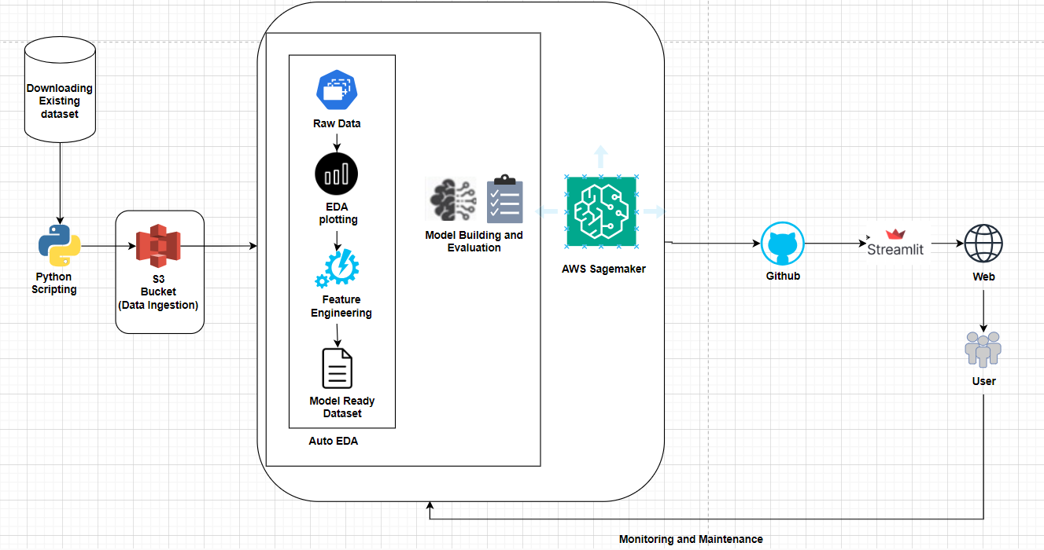
Previous Methodology - CRISP – ML(Q)
Model Development Pipeline

Slide 7
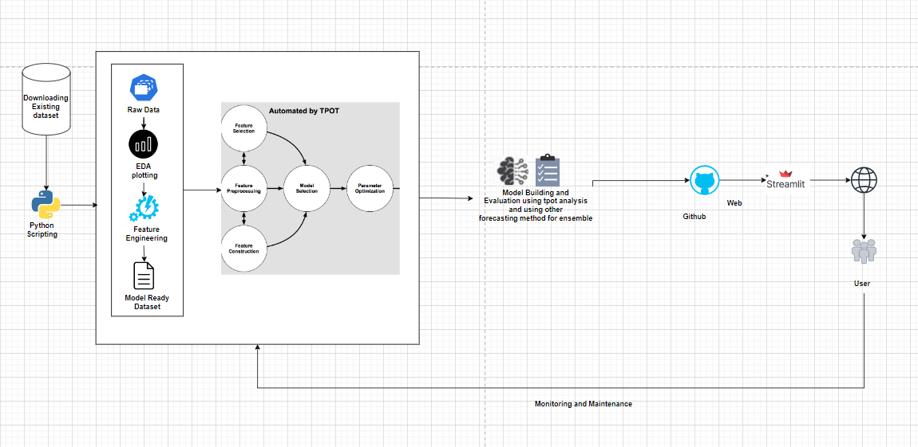
Current Methodology - CRISP – ML(Q)
Model Development Pipeline

Slide 8
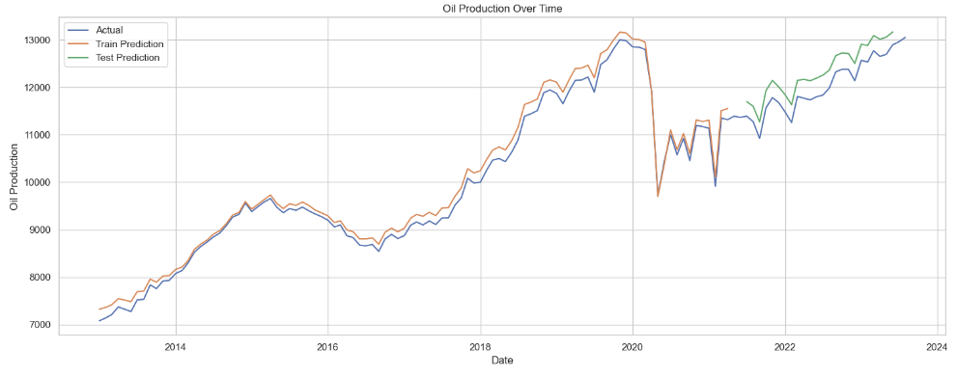
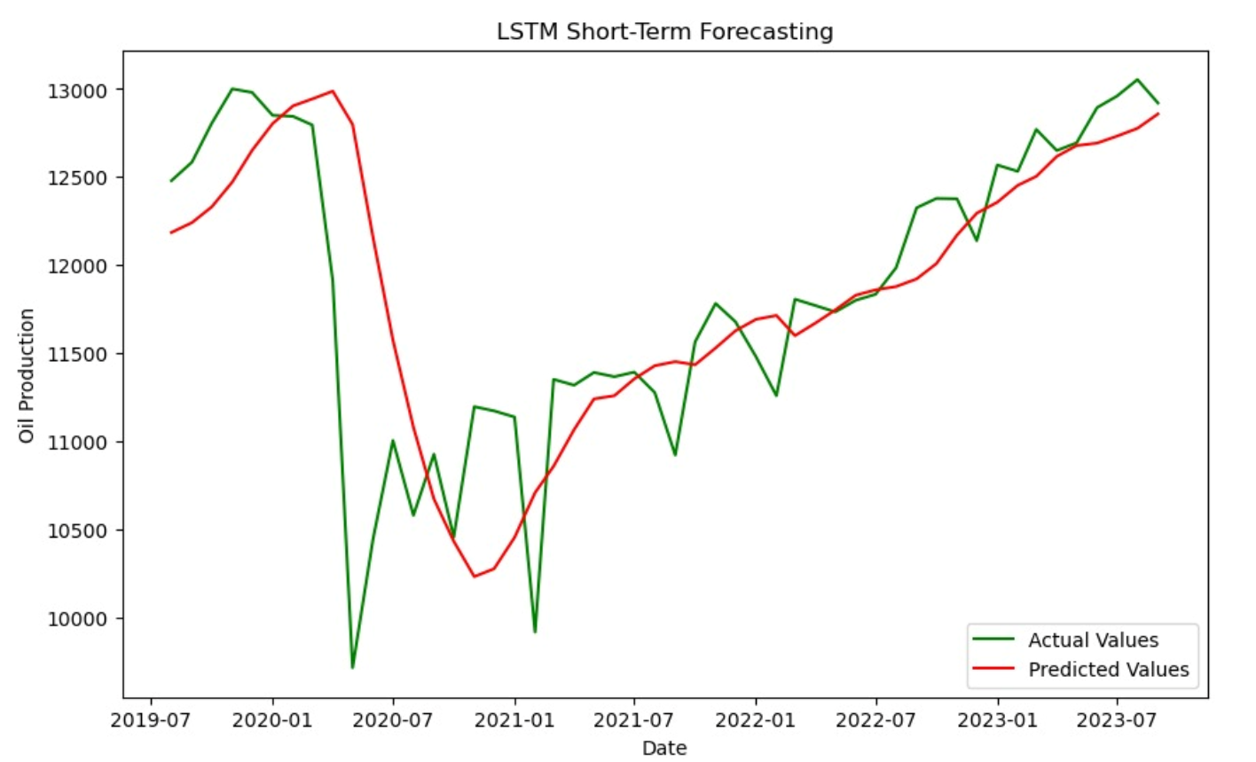
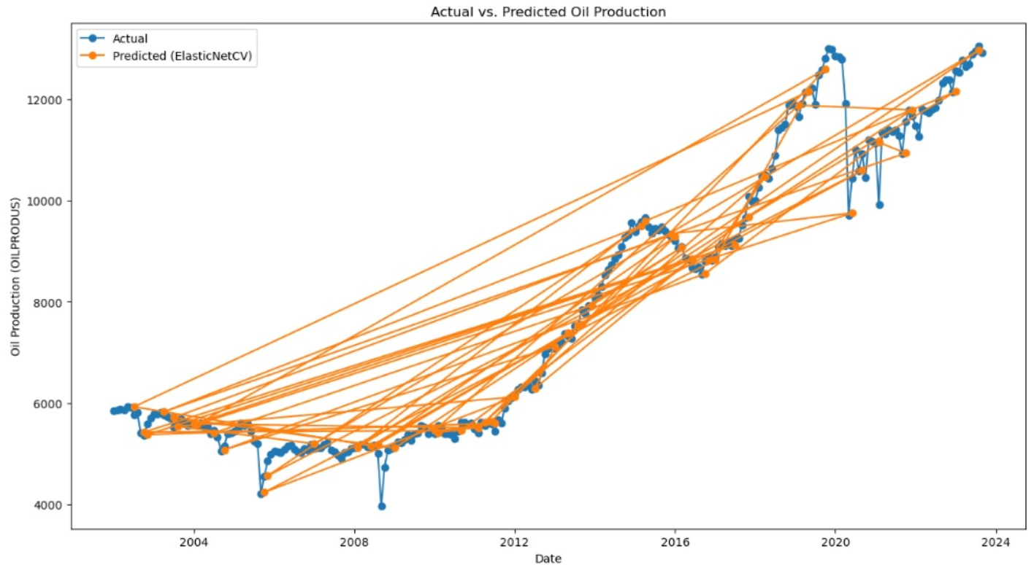
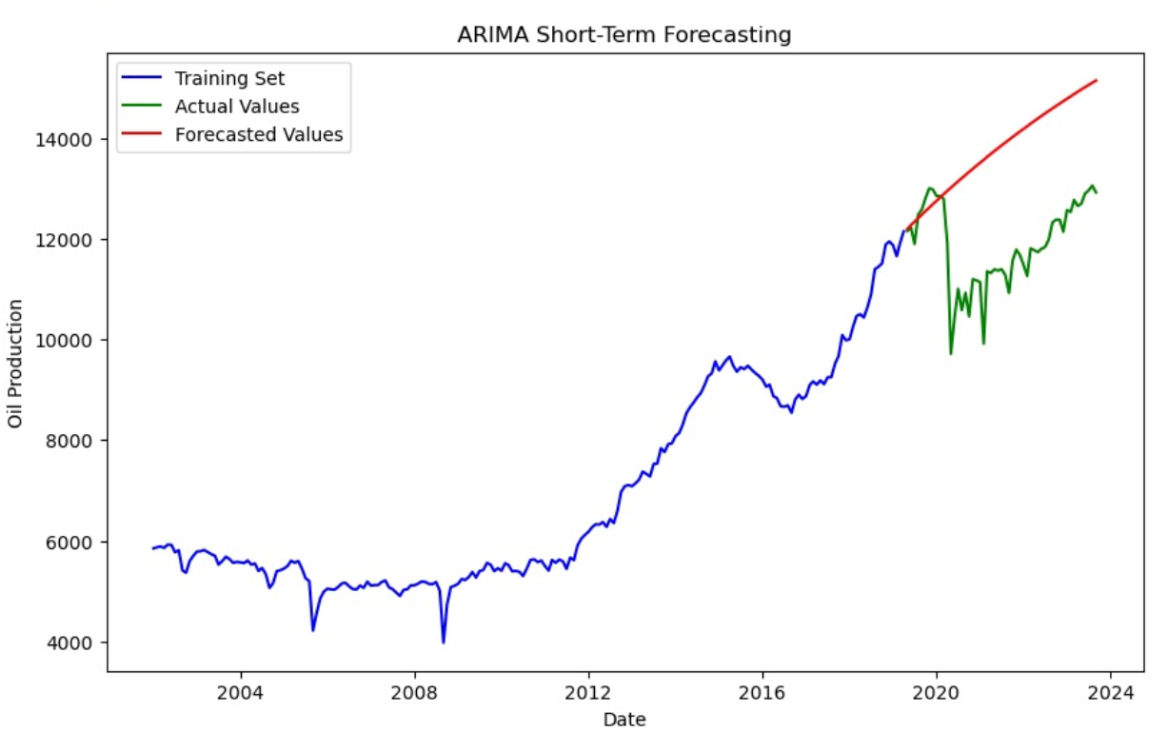
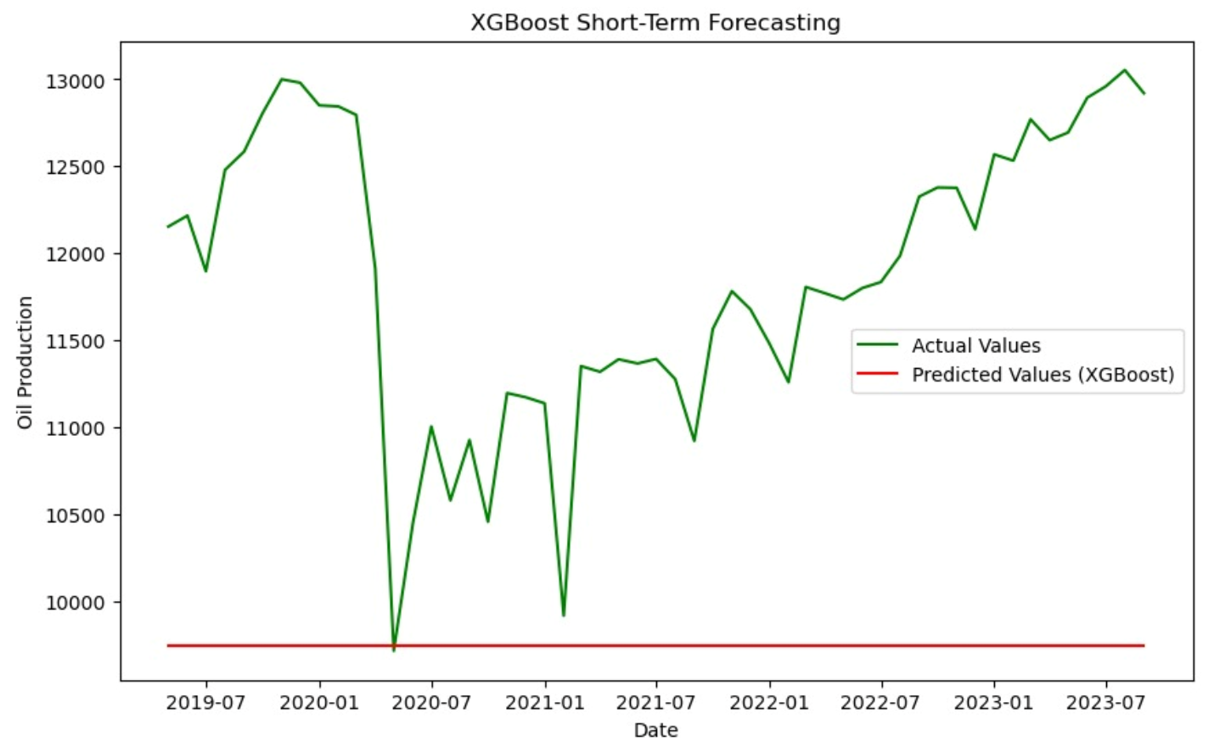
Modeling Phase
Modeling
LSTM
Various factor on which the choice of modelling techniques depends
Business objectives,
The data
The boundary conditions of the project the ML application is contributing to.
The requirements and constraints that have been defined in slide #2 are used as inputs to guide the model selection to a subset of appropriate models.
The goal of the modeling phase is to craft one or multiple models that satisfy the given constraints and requirements.
Map the system : Time-Series Forecasting
Long-term forecasting is a method of predicting future events, trends, or conditions over a period of five years.
Short-term forecasting is a method of predicting future over a relatively brief timeframe, typically for a year.
Select modeling tools : ARIMA, LSTM, ElasticNetCV, XGBoost
Implement model : Selection of appropriate values for the various parameters of the models.
T-Pot analysis
ARIMA
XGBoost
Notes:
Evaluation : Error metric : Models exhibiting lower error metrics than the baseline model will be selected for constructing the forecasting product.
We take 20 years of data use the first ten for the train and test to forecast then we show how close we are with respect to the 11th year for the short term, and 15years for long term.

Slide 9
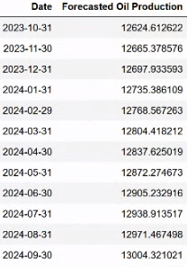
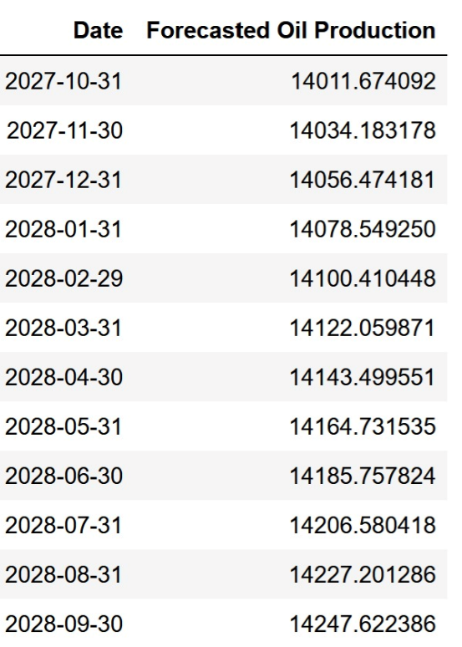
Modeling Phase
Evaluation
Assess the feasibility of deploying the system in a real-world setting, considering factors such as scalability and resource requirements.
Evaluate model:
Based on the error metric and forecasted values.
Compare results with defined success criteria:
Error metric : MAPE is chosen as the error metric for assessing the benchmark model and comparing it to other machine learning models.
*Forecasted values post implementing ensemble
Short Term Forecasting
Long Term Forecasting
Model Implemented | MAPE Value
T-Pot (ElasticNetCV) | 2.06%*
LSTM | 3.33%*
ARIMA | 17.04%
Ensemble(ElasticNetCV + ARIMA) | 16.33%
MAPE Value of implemented Model
Notes:
Evaluation : Error metric : Models exhibiting lower error metrics than the baseline model will be selected for constructing the forecasting product.
We take 20 years of data use the first ten for the train and test to forecast then we show how close we are with respect to the 11th year for the short term, and 15years for long term.

Slide 10
Modeling Phase
Deployment
Monitoring and Maintenance
Build a Streamlit app that allows users to see the forecasted values on the interface.
Use Git as version control to track changes to the codebase and ensure reproducibility of the model.
Collaborate with other team members and track progress through Git's collaborative features.
On-Premise model deployment considered to have more control for data privacy and sharing sensitive information.
Continuously monitor the app's performance and user feedback to make improvements, as necessary.
Performance Monitoring: Monitor model performance and system behavior.
Utilize Streamlet's built-in analytics dashboard to track usage, user feedback, and errors.
Maintenance: Regularly update and maintain model.
System Level Maintenance : Regularly check if the app is running and self launch the application incase the script is not running – by using scheduler
Certain external factors might influence our model to predict inaccurately such as technology, market conditions, geopolitics, trade policies and global oil demand.
In such situations the model will need to be updated to account for the changes, a drop in accuracy ~ 80% (that means increase of percentage error > 20%) will trigger us to re-train the model.
In case of any excess or deficit in oil production around 25%, considering potential business and economic impact we can re-evaluate and re-train the model.
Notes:
Sonali/Adarsh

Slide 11
Reference:
https://www.forex.com/ie/news-and-analysis/top-ten-most-traded-global-commodities/#:~:text=Brent%20Crude%20oil%20is%20the,expensive%20than%20WTI%20crude%20oil.
THANK YOU

